Slide 1
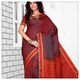
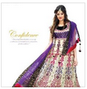
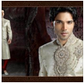
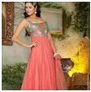
Website template
Header
Navigation
Body
Footer
Browse Categories
Join us on Terms & Conditions Delivery & Return Privacy policy (c) 2012-2013

Slide 2
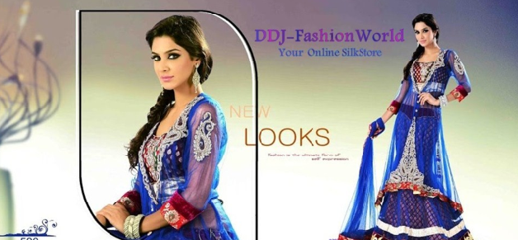
Centre images will animate

Slide 3
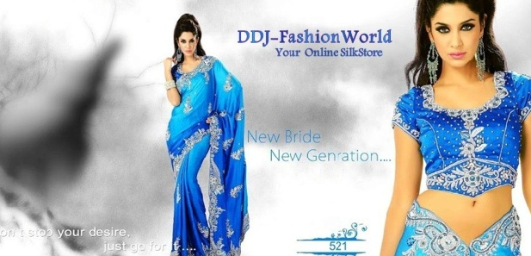

Slide 4
GBP (£)
Euro (€)
DDK (kr.)

Slide 5
Girls
Boys
Centre images will animate

Slide 6
Sherwani
Kurta
Centre images will animate

Slide 7
Salwar
Sarees
Designer collection
Lehenga
Centre images will animate

Slide 8
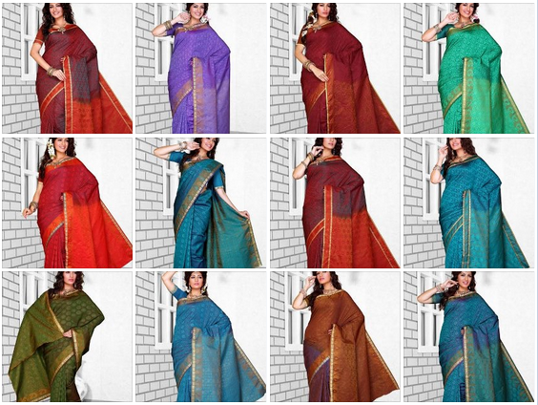
Women -> Sarees
Collection 1

Slide 9
Women -> Sarees
Collection 1
Collection 2
Collection 3

Slide 10
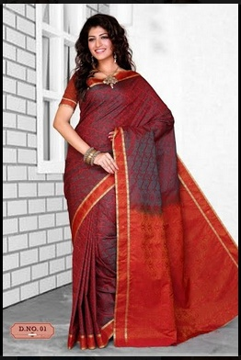
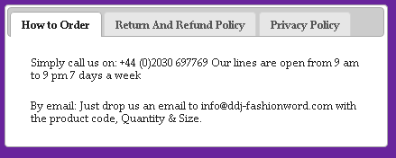
Women -> Sarees
Saree 46
Cost: £102
Description:
Color: Black yellow
Fabric: xyz
READ:
Header and footer
Width will expand with
The body cannot show this
Here but will be fine on
The actual website.

Slide 11
Salwar
Women -> Sarees
Sarees
Designer collection
Saree 46
Cost: £102
Description:
Color: Black yellow
Fabric: xyz
Suits

Slide 12
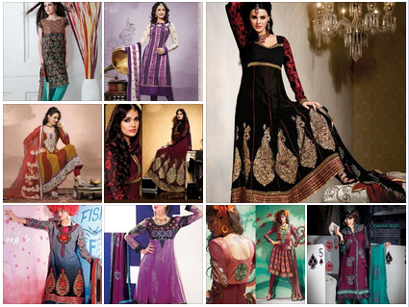
Women -> Designer Collection

Slide 13
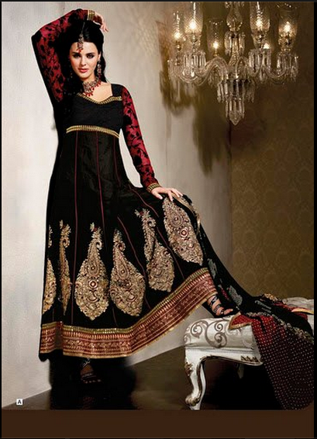
Women -> Sarees
Saree 46
Cost: £102
Description:
Color: Black yellow
Fabric: xyz

Slide 14
Great products on Sale!

Slide 15
About Us
Our aim is to offer you something different. With the modern busy life, we want to make shopping for Tamilan, Indian, Bangladeshi & Pakistani clothes easier, providing you with the latest South Asian fashion!
Description
Our aim is to offer you something different.
With the modern busy life, we want to make shopping for Tamilan, Indian, Bangladeshi & Pakistani clothes easier, providing you with the latest South Asian fashion, the best customer service and all delivered directly to your door.
We keep a close eye on South Asian and Western fashion trends and collaborate this to bring you the very latest in Indian fashion.

Slide 16
Delivery & Return
Need copy?

Slide 17
Privacy policy
Need copy?

Slide 18
Terms & Conditions
Need copy?

